Slide 1
Comparative Analysis of Tomato Disease Classification: A Performance Evaluation of CNNs and Traditional Classifiers with Explainable AI
Task 5: Paper Second Draft
Team : 5
Abu Bakar Hasnath (20301037),
Sabista Ifraj (20301175),
Sameha Kamrul (23266016),
Sania Azhmee Bhuiyan (23266033)
CSE713: Advanced Syntactic Pattern Recognition
Instructor: Annajiat Alim Rasel (AAR)
RA: Md. Humaion Kabir Mehedi
ST: Farah Binta Haque

Slide 2
Outline
Dataset
Data Preprocessing
Methodology
Result analysis

Slide 3
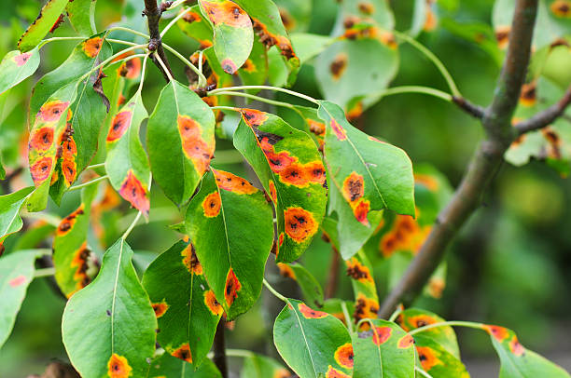
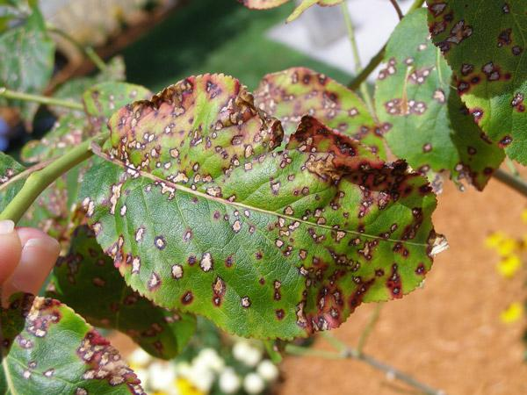
Dataset
Hybrid dataset
Collected from kaggle
Plant village and Tomato Disease
Consists of 20k and 20.6K respectively

Slide 4
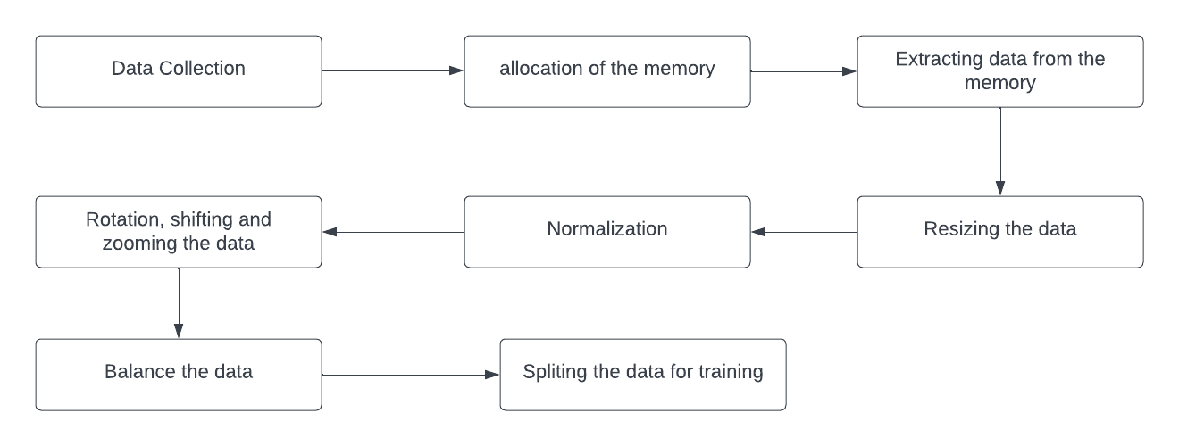
Data Preprocessing
Data preprocessing

Slide 5
Methodology
InceptionResNetV2:
deep convolutional neural network architecture
developed by Google's research architecture team
kernel size (1*1), (3*3), and (5*5)
residual connection intercorporate
Notes:
Healthcare Data Challenge: Healthcare faces challenges in accessing diverse datasets, as medical data is distributed across many institutions globally.
Legal and Regulatory Barriers: Centralized data aggregation for AI training in healthcare is increasingly restricted due to legal and regulatory barriers protecting data privacy.

Slide 6
Methodology
InceptionV3:
Evolved from InceptionResNet V2
capture features at different scales
inception modules are the key component
Auxiliary classifiers are also added to mitigate the layers

Slide 7
Methodology
ResNet50:
deep convolutional neural network architecture
developed by the Microsoft Research team
bottleneck architecture is used
balance of depth and computing efficiency

Slide 8
Methodology
VGG16:
convolutional neural network architecture
developed by Visual Graphic Group (VGG) at University of Oxford
multiple convolutional layers with 3*3 filters
Max pooling layers preserve the most significant features

Slide 9
Methodology
Vision Transformer:
an architecture for image classification
reads the image sequence and processes it using a transformer encoder
Each patch is linearly embedded into a lower-dimensional vector space
final output token is classified by processing it via a classification head

Slide 10
Methodology
Explainable AI:
Contributes in prediction
SHAP (SHapley Additive exPlanations), and LIME (Local Interpretable Model-agnostic Explanation) contributes in input
XAI approaches produce interpretable outputs,
Give insights into the decision making process of AI models

Slide 11
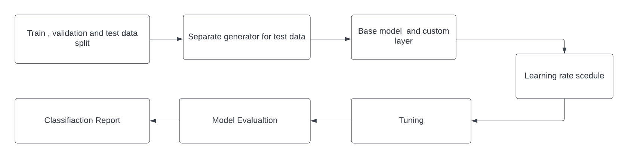
Methodology

Slide 12
Result Analysis
InceptionResNetV2 | 99.17%
InceptionV3 | 95.44%
ResNet50: | 92.97%
VGG16: | 82.76%
Vision Transformer | 30.21%

Slide 13
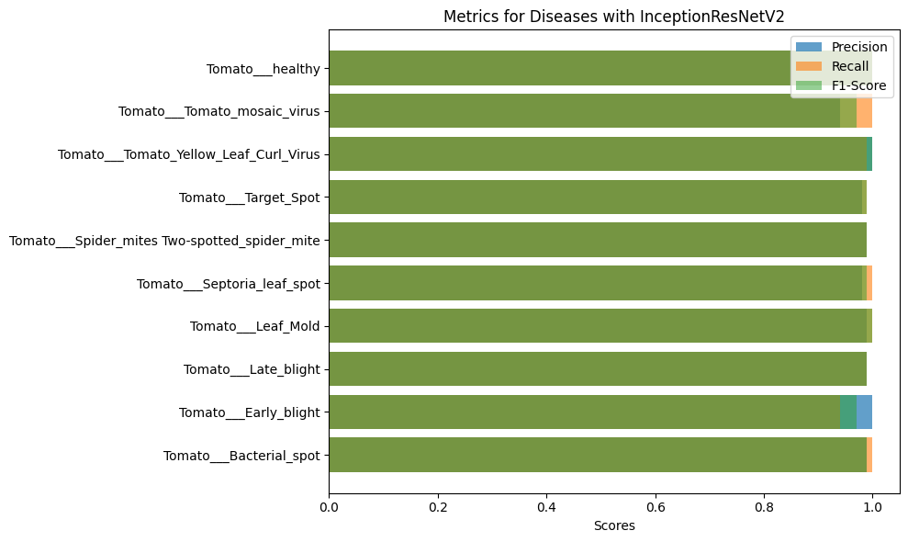
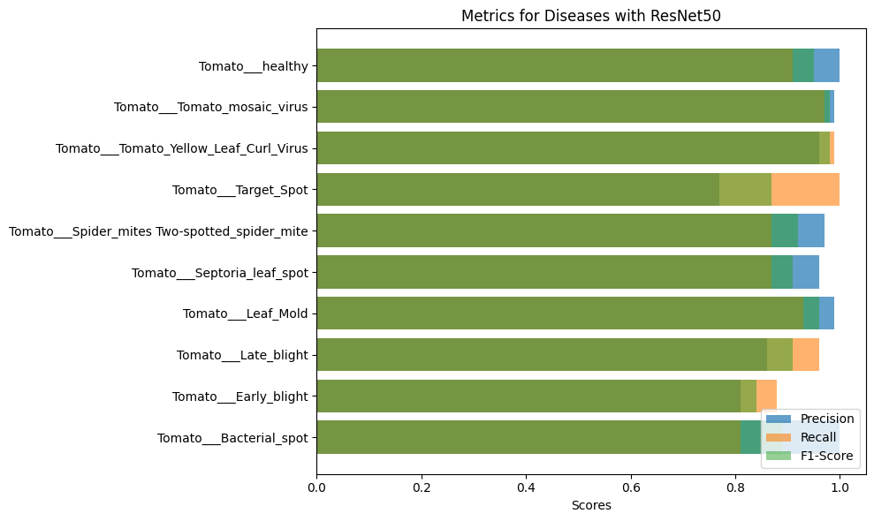
Result Analysis
InceptionResNetV2
ResNet50

Slide 14
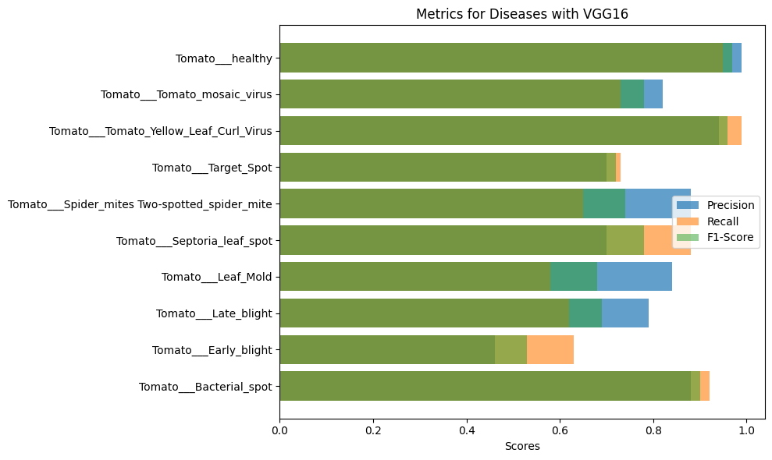
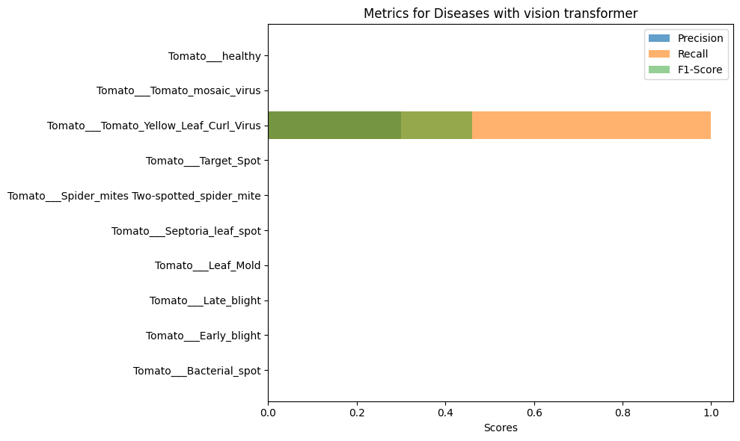
Result Analysis
VGG16
Vision transformer

Slide 15
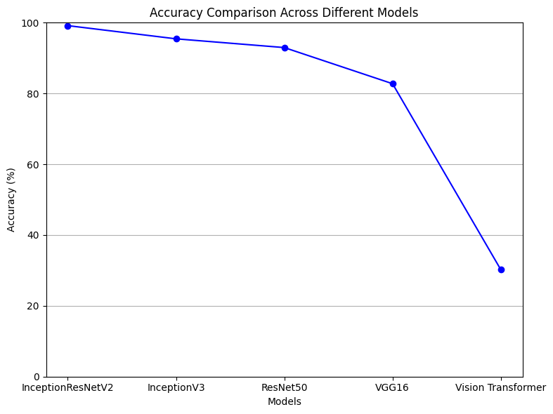
Result Analysis

Slide 16
Reference
[1] Thakur, P. S., Khanna, P., Sheorey, T., Ojha, A. (2022). Explainable Vision Transformer Enabled Convolutional Neural Network for Plant Disease Identification: PlantXViT. arXiv preprint arXiv:2207.07919.
[2] Borhani, Yasamin Khoramdel, Javad Najafi, Esmaeil. (2022). A deep learning based approach for automated plant disease classification using vision transformer. Scientific Reports. 12. 11554. 10.1038/s41598-022-15163-0.
[3]Anim-Ayeko, A. O., Schillaci, C., Lipani, A. (2023). Automatic blight disease detection in potato (Solanum tuberosum L.) and tomato (Solanum lycopersicum, L. 1753) plants using deep learning. Smart Agricultural Technology, 4, 100178. https://doi.org/10.1016/j.atech.2023.100178

Slide 17
Thank you for listening

